Slide 1
Lesson Overview
Begin with the Stop & Think -3min. Have a brief discussion (no more than 5 min, just get 2-3 ideas out on the table)
Review-What we figured out and what we still don’t know 5min– No need for discussion just ask the question get a few ideas out and then move on. They should know this. Focus on thee questions for today.
Simulation on MEME 10min- Tell them that the goal today is to figure out the answer to: “why did the algae bloom?” using the simulation.
Discussion 7min– What have we learned from the simulation.
MEME Studies 15min-- have groups continue on MEME and work with the new resources (6 of them) that are studies.
Before you go 3min- if time permits. It’s similar (reversed) as the Stop & Think
Total time- 50 mins.

Slide 2
LESSON 4 - DAY 2

Slide 3
STOP & THINK!
Grab handout 2 and put your name and information on the top of the first page.
Complete the STOP & THINK! question on the first page.
What is something that you can learn from a scientific study but that you can’t learn from a simulation?
Notes:
Use this “Stop & Think” as a do now. 3min
Have a very brief class discussion, just get 2-3 ideas out.
.

Slide 4


What have we figured about why the fish dying?
Decomposers use up air when breaking down dead matter. The more decomposers the less air.
After the algae bloomed there was a lot of dead matter all of a sudden and this allowed decomposers to grow and multiply.
The more decomposers the less dissolved air.
Our question today: Why was there so much algae all of a sudden? What causes algae to bloom?
Notes:
5min Slide is animated. Brief Review
Ask what we figured out– they should eb able to say a few things (we did this yesterday)—this is just a review keep it brief.
Then ask –what do we still need to know– they should ask about algae but if not just show the question and move on

Slide 5
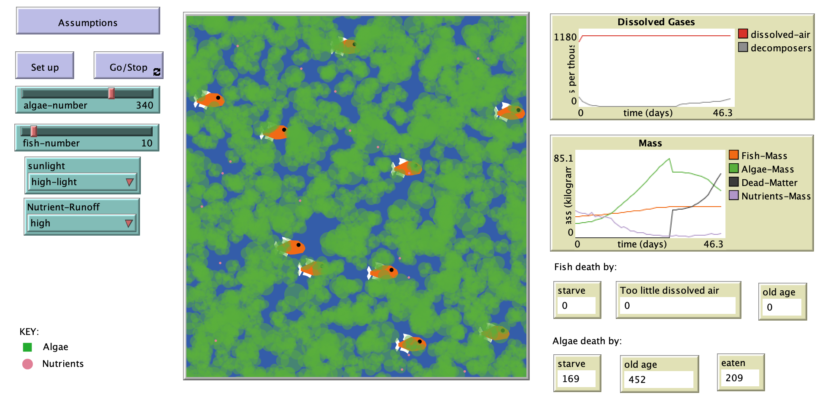





Simulation
Our question today: What causes algae to bloom?
Use the simulation to figure this out.
Revise your model accordingly.
Make sure your model meets the new class criteria.
Dead Fish
Notes:
10 min work with simulation--Goal for today is to answer the questions of what cases algae to bloom.
They should be using the sim to figure this out.– what makes algae grow.

Slide 6

MEME
Try to use the simulation to figure out what is causing the algae to grow so much. Run the trials below keeping fish, algae the same and decomposers on
Nutrients Trial:
Click “Reset”
Set the nutrients to low. Run the simulation.
Now, set the nutrients to medium. Run the simulation again.
Now, set the nutrients to high. Run the simulation again.
Sunlight Trial:
Click “Reset”
Set the sunlight to low. Run the simulation.
Now, set the sunlight to medium. Run the simulation again.
Now, set the sunlight to high. Run the simulation again.
Dissolved Air Trial:
Click “Reset”
Set the dissolved air per tick to 0. Run the simulation.
Now, set the dissolved air per tick to 50. Run the simulation again.
Now, set the dissolved air per tick to 100. Run the simulation again.
Notes:
In case they don’t know what to do, this is from yesterday

Slide 7
Simulation
Our question today: What causes algae to bloom?
How does sunlight affect algae growth?
How do nutrients affect algae growth?
How does air affect algae growth?
If you want a lot of algae what would you do in the simulation?
What makes more algae- more light or more nutrients
Notes:
7 min Discussion of simulation– Slide is animated. what did we learn from the sim. How did each of these variable affect growth
Technically all of them are needed. Plants don’t grow well without much light and they die without air. With low nutrients they also die. So the thing that makes them grow the most when you add it is nutrients. While all of these are important its nutrients that make the most difference

Slide 8
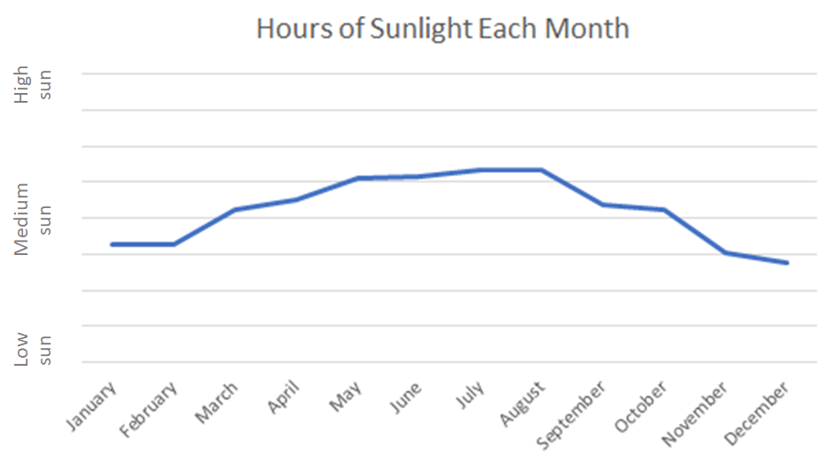
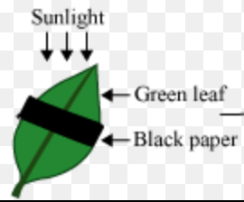
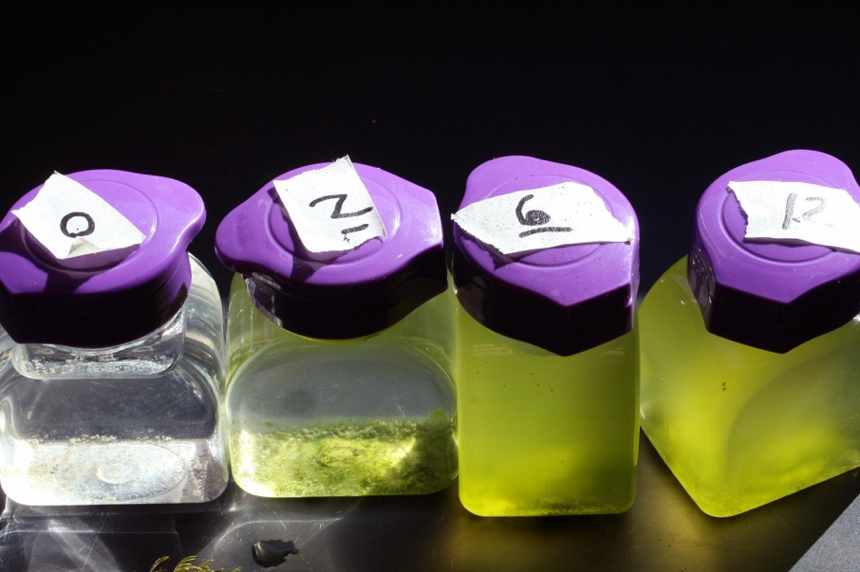
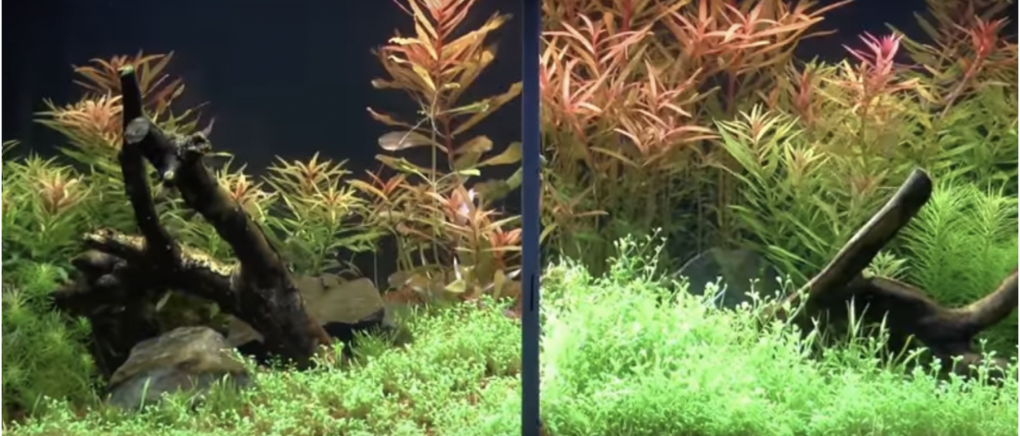
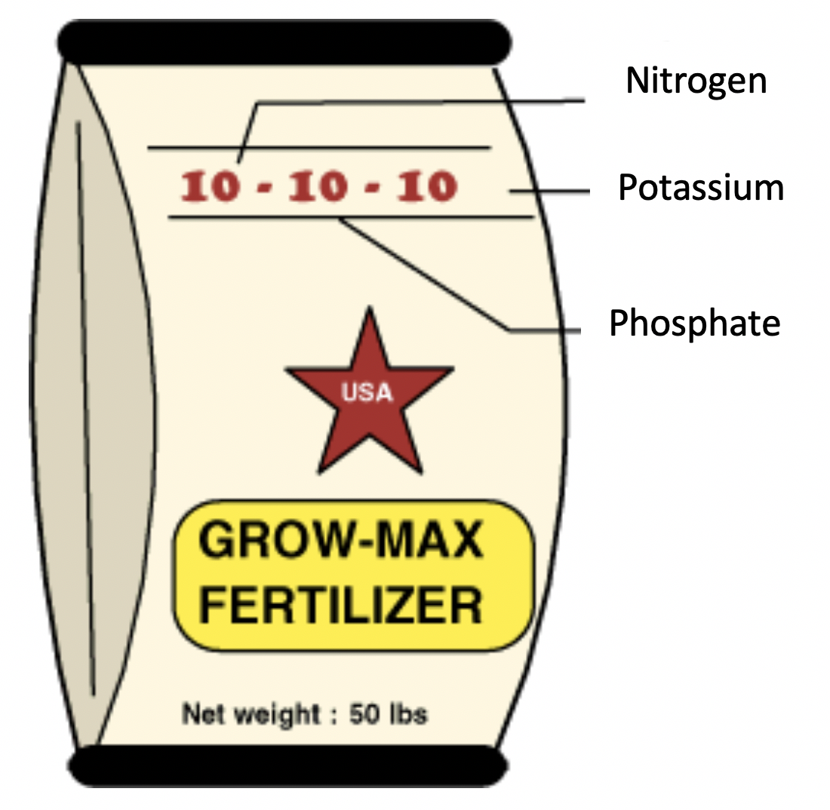
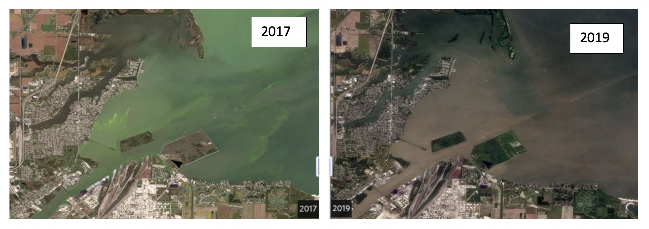
Let’s use evidence to figure out why there are more algae.
Discuss ALL the evidence pieces in pairs and answer the questions individually. Change your model based on new evidence!
Sunlight at Passion Puddle
Plants in Sunlight
Fertilizer and Plants
Air in Aquariums
Fertilizer Labels
Lake Erie Algal Blooms
Notes:
15 min work with MEME with new resources. They will have more time tomorrow, but should get through at leats 3
They can look at them in any order.
They should think about how these relate to their models. This will be updated with images from the final versions of the resources.

Slide 9
BEFORE YOU GO
Complete the BEFORE YOU GO questions.
What is something that you can learn from a simulation (that you can’t learn from a scientific study)?
Notes:
END OF DAY 2 3min
This is very similar to the stop&think question, but “backwards” (the stop and think was about why you can only learn from a study, this one is from you can only learn from a simulation). If the kids ask about it, remind them to read the question carefully, and focus on what you can only learn from a SIMULATION.
Use this “Before You Go” as an exit ticket.
Tell students they will be figuring this out in future classes.
Do not hold a class discussion at this point, and keep it brief at the end of class.

Slide 10

Evidence Discussion
Let’s think about the simulation from yesterday, and the scientific study in study Resource Y (Fertilizer and Algae)
If a scientific study contradicts your model, what should you do?
If a simulation contradicts your model, what should you do?
Notes:
I may update this as we finalize the evidence.
The study shows that they grow better with fertilizer. Also, the study can show you what actually happens – it’s not speculative, it’s real life.
The simulation shows that algae grow better with more dissolved nutrients. Also, the sim lets you try things out a bunch of times to see what affects what – you can’t do that with a study unless you rerun it – it takes a lot of time!
Putting them together might help figure out where the nutrients are coming from.

